Slide 1
MS/MS Viewer Project
Tejaswini Oak

Slide 2
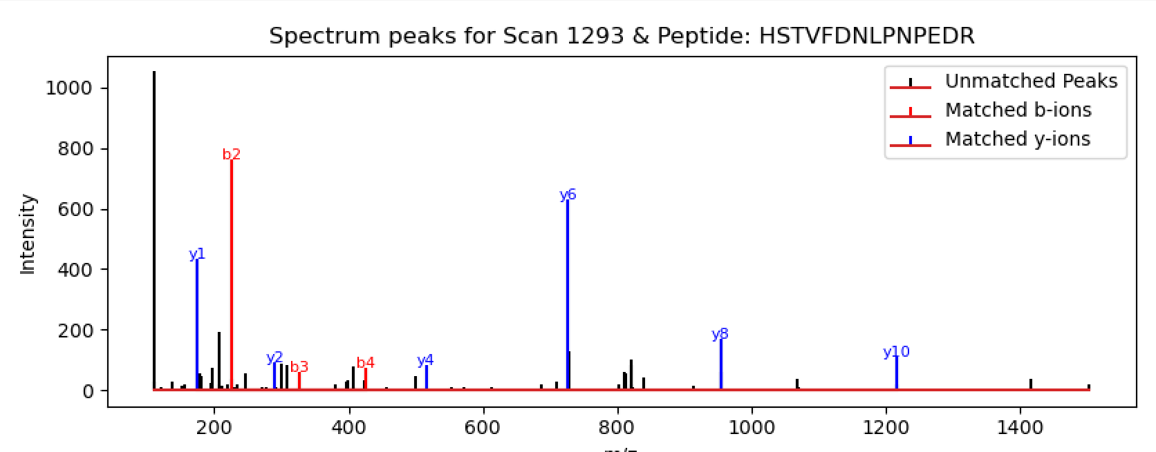
Program Requirements
Program takes 3 inputs from the user (file name, scan number and peptide sequence) XML_file = sys.argv[1] scan_number = sys.argv[2] peptide_seq = sys.argv[3]
Computes the theoretical values of b and y ions and matches the m/z values to the peaks compute_ions( ) annotate_peaks ( )
Program must output a plot, so user can see if the peptide is a good match for the spectrum

Slide 3
Modules
Sys: provides access to variables and functions that interact with the and exits the program when error occurs
Os: provides a way to interact with the operating system
Os.path: provides for manipulating file and directory paths
Base64: provided b64decode function to decode data from the XML file
Array: used for storing m/z values and intensities of the peaks
xml.etree.ElementTree as ET: used to parse through the XML file
Matplotlib.pyplot: used for plotting the spectrum

Slide 4
Straightforward / Difficult Aspects
Straightforward:
Parsing through the file
Computing b/y ions
Error handling
Difficult:
Understanding the tolerance and how it affects my plots

Slide 5
Error Encountered

Slide 6
Lessons I learnt
Bioinformatics
Understanding spectral data
Protein chemistry
Peptide fragmentation
Programming
Error Handling
Problem-Solving

